Slide 1
Hike Safely:
A Navigation Mobile Application for Hikers
By Ding Ziheng ,
Kresna-Abraham, LI Sheung Shing
Advised by Prof. Tai Chiew-Lan

Slide 2
Content and flow
Introduction
UI Design
Backend
Implementations
Conclusions
Live Demos

Slide 3
Introduction
“Hike Safely: Navigation Mobile Application for Hikers”
Comprehensive and user-friendly hiking-safety companion app
Safety features such as Blackspot detection and instant weather information
Hiking history and route recommendations

Slide 4
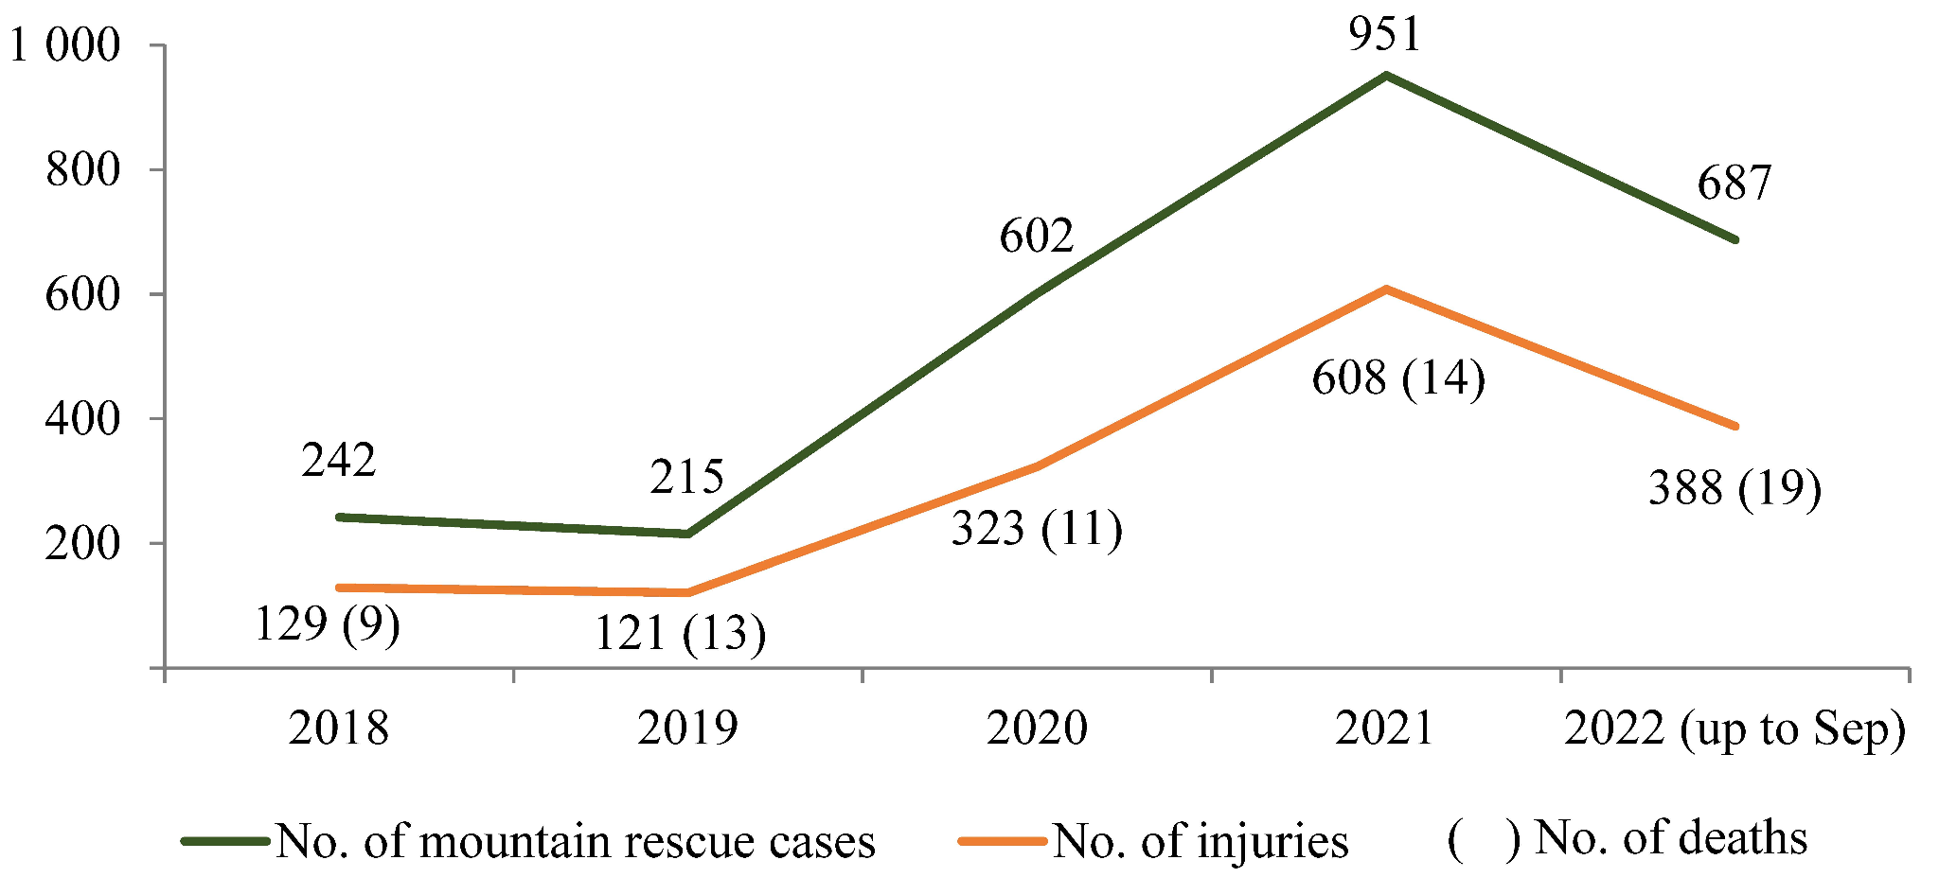
Background
Project started at Pandemic situations, more beginner started hiking
Increasing trends of rescues and casualties
Figure 1 –
Mountain rescues and casualties in Hong Kong, 2018-2022

Slide 5
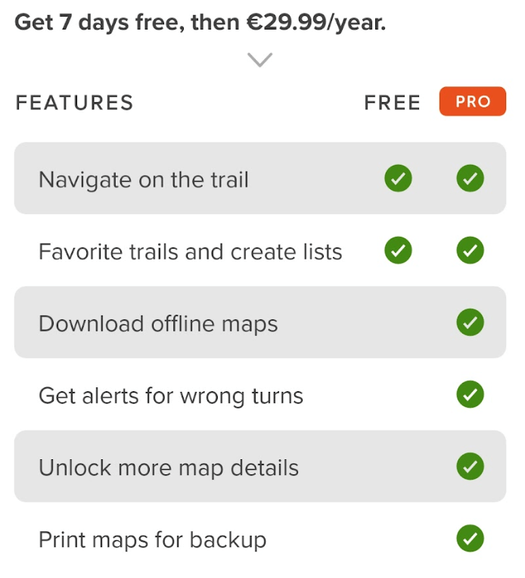
Problems on Existing Apps
Lack of safety features
Lack of instant weather conditions
Requires subscription to unlock functions

Slide 6
Objectives
Offer Instant Information
Include speed/distance/duration/altitude
current location and direction
Assist Route Planning
Select featured trails
Generate hiking paths by Dijkstra’s Algo
Enhance Safety
Notify users when nearby blackspots
Provide real-time weather updates
Record and track hiking journeys
Allow users to review prior hikes, aggregate distance and completed routes

Slide 7
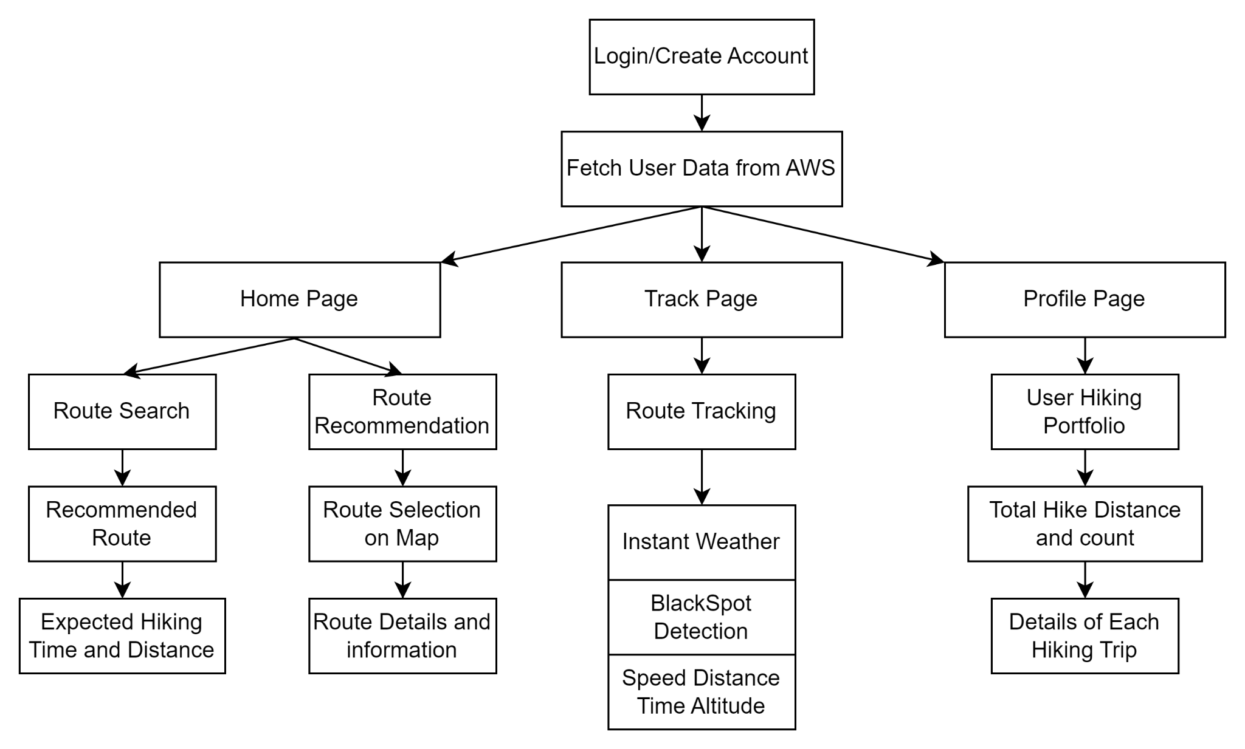
General UI

Slide 8
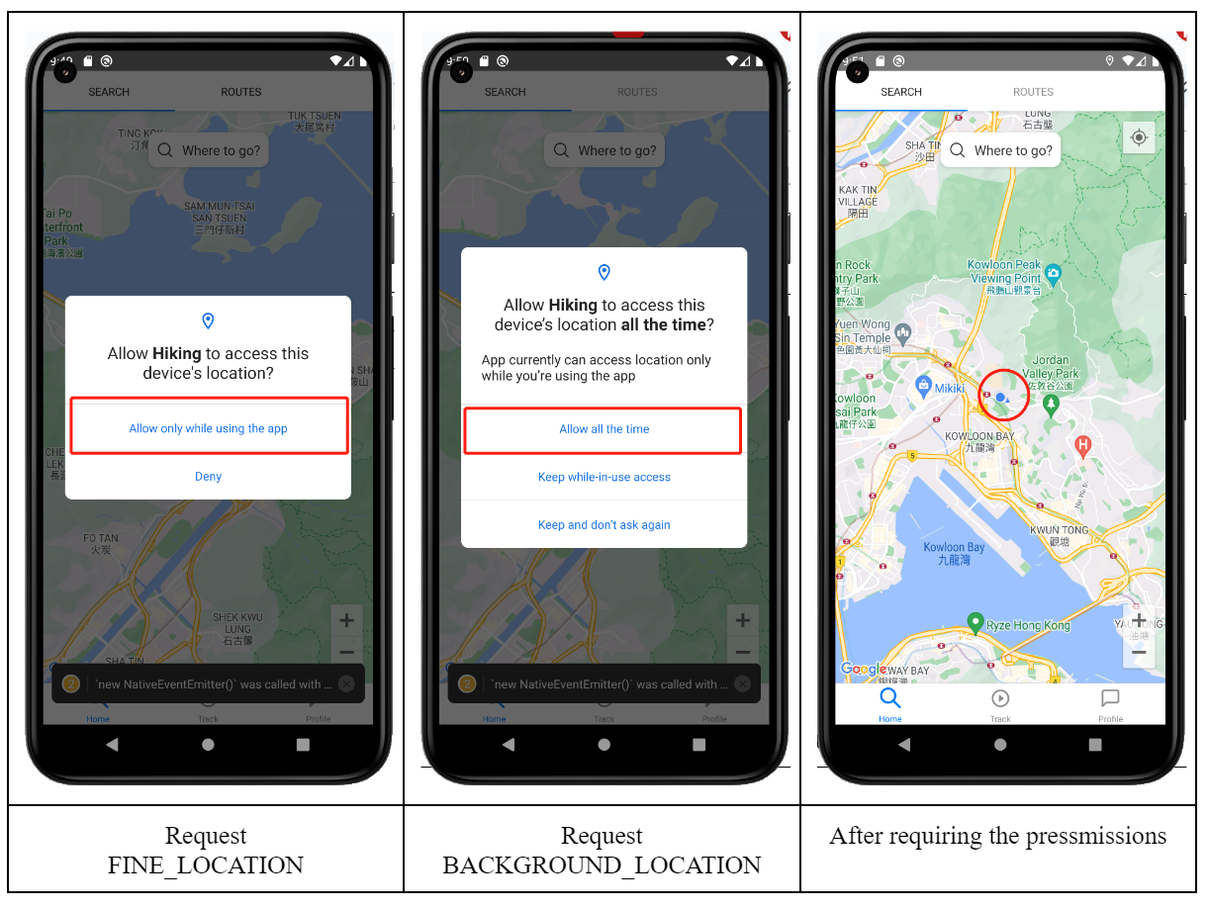
Seek Permission

Slide 9
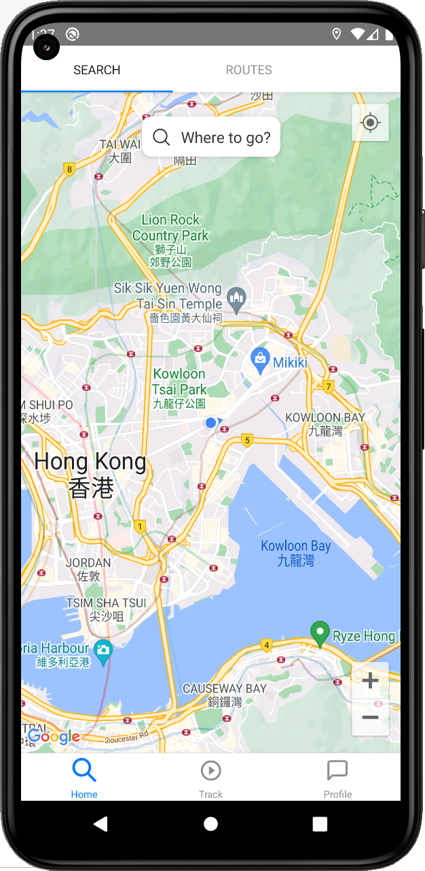
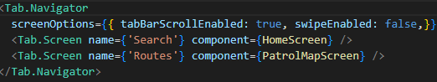
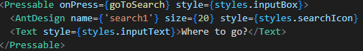
Home Page UI
Two Tab Nav Bar:
“Where to go” Pressable button

Slide 10
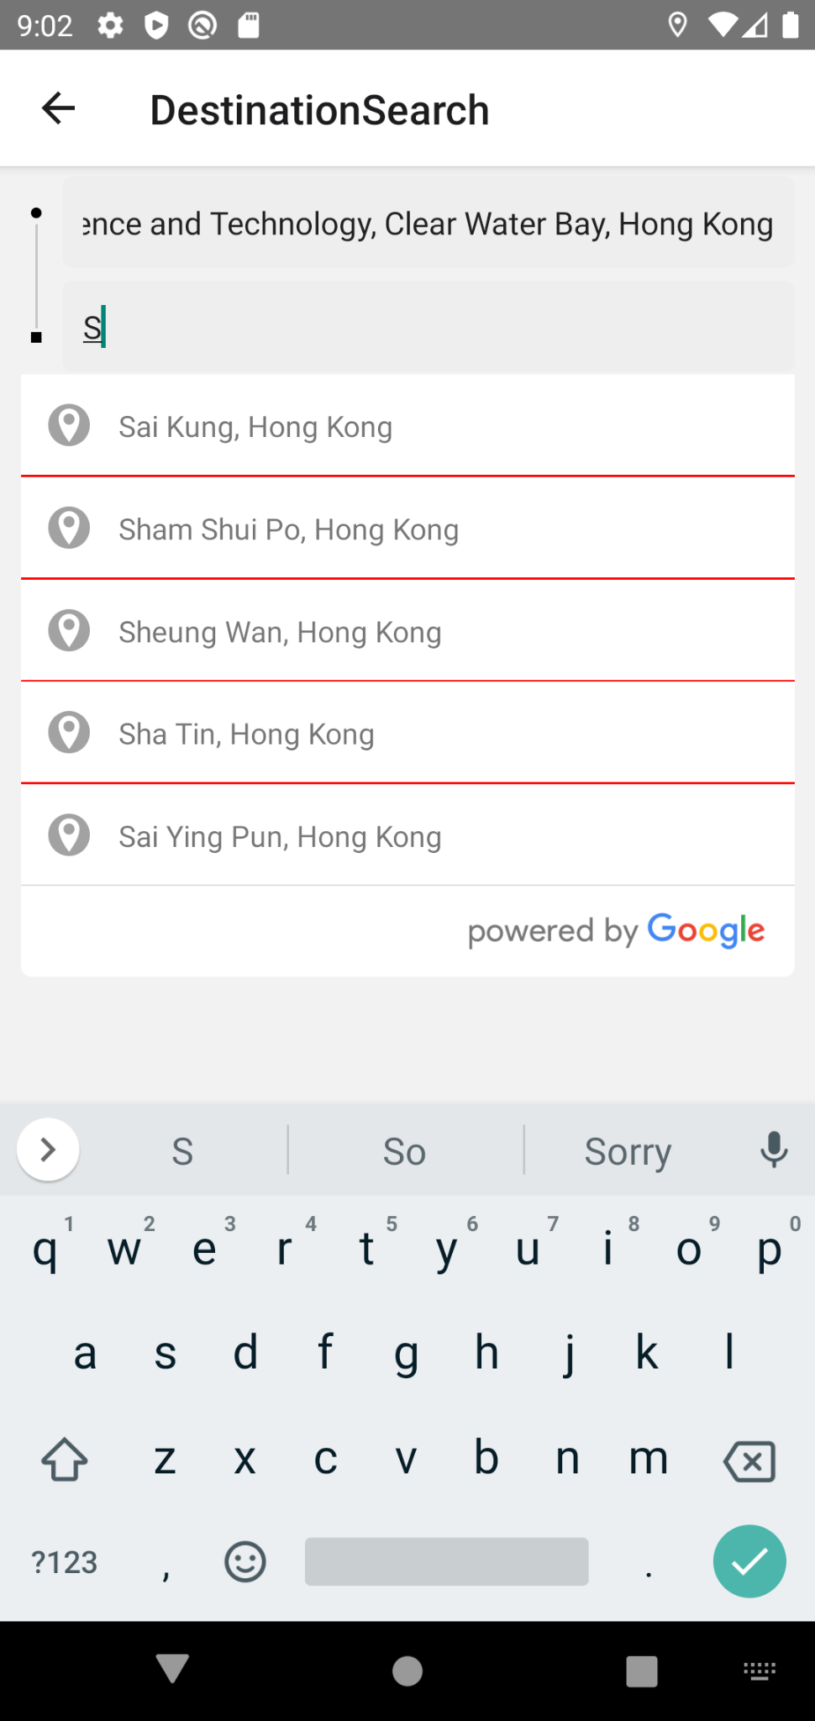
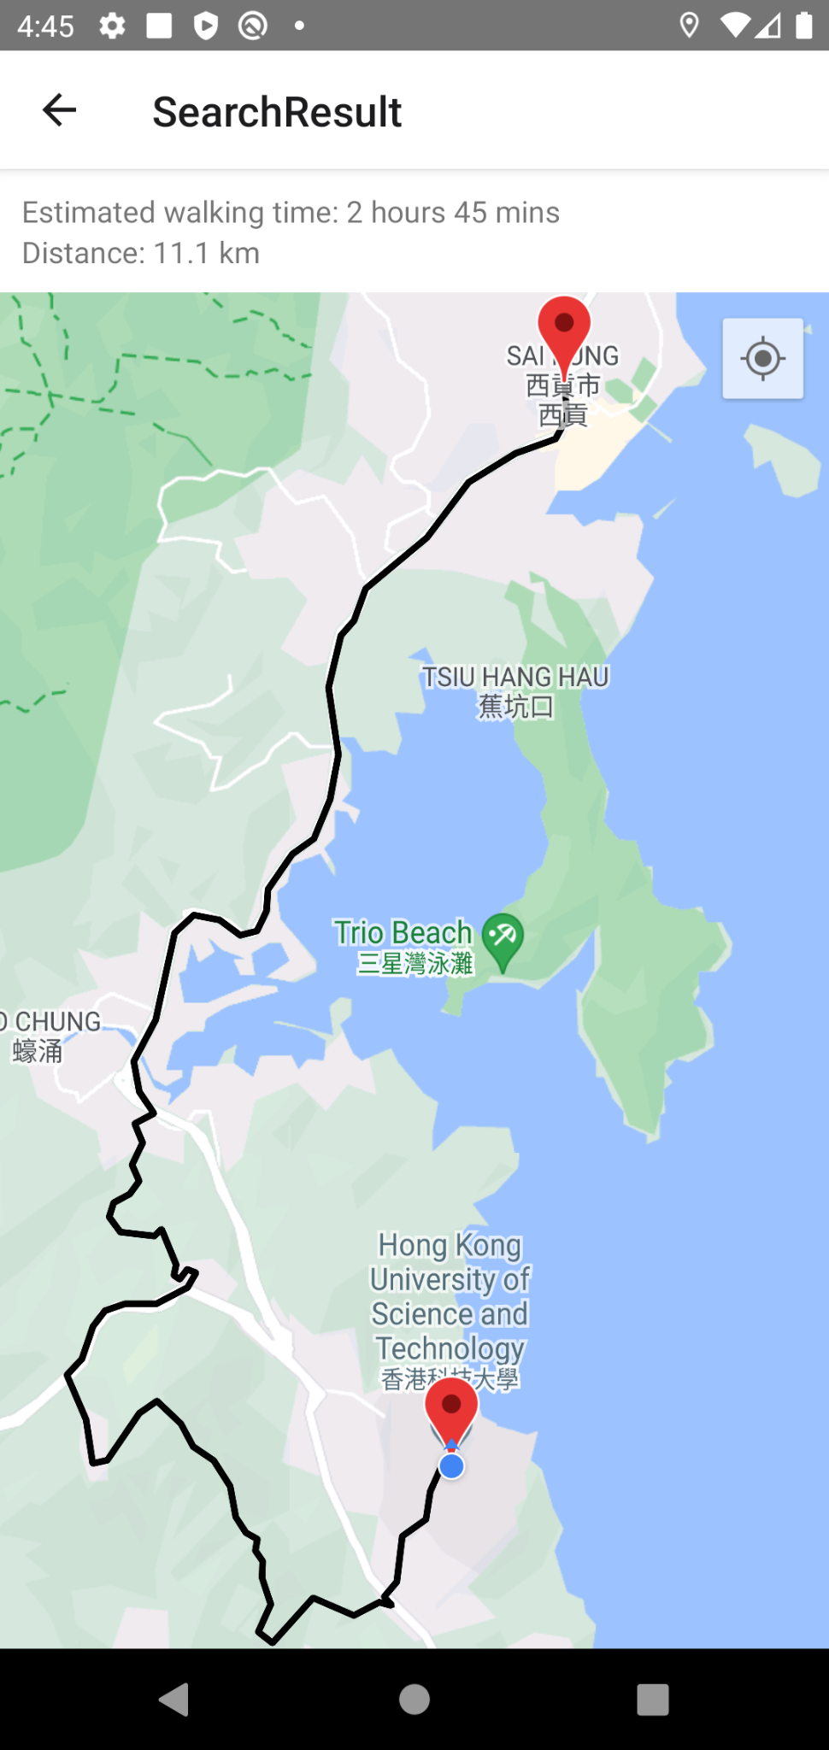
Route Search UI
Two Textbox containers with Autocomplete function
Result Page:
Text View showing Time and Distance
Marker and Polyline shows the route

Slide 11
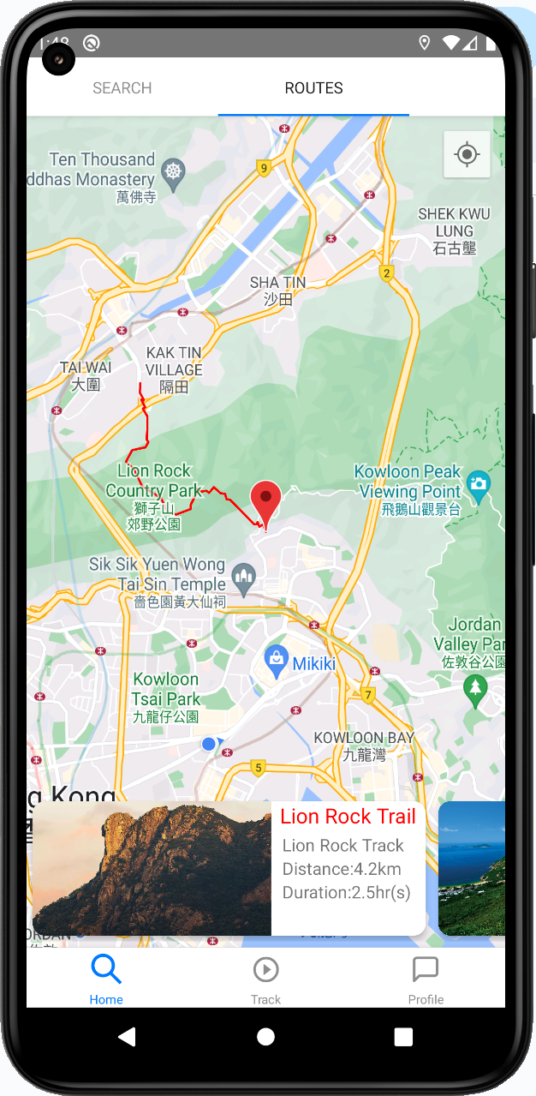
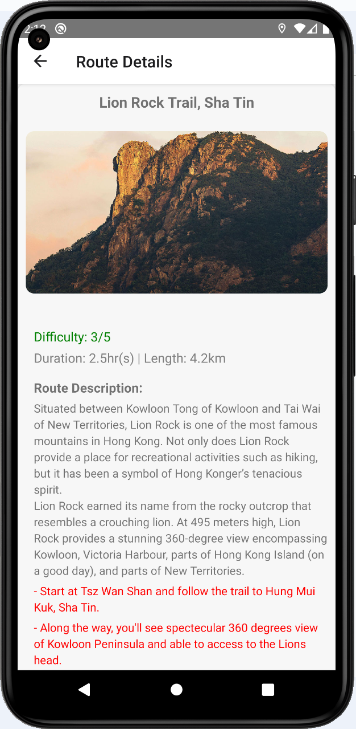
Route Recommendation UI
Mapview with Routeline
Pressable/Scrollable FlatList
Allows user press for details
Route Details:
Fetched from database

Slide 12
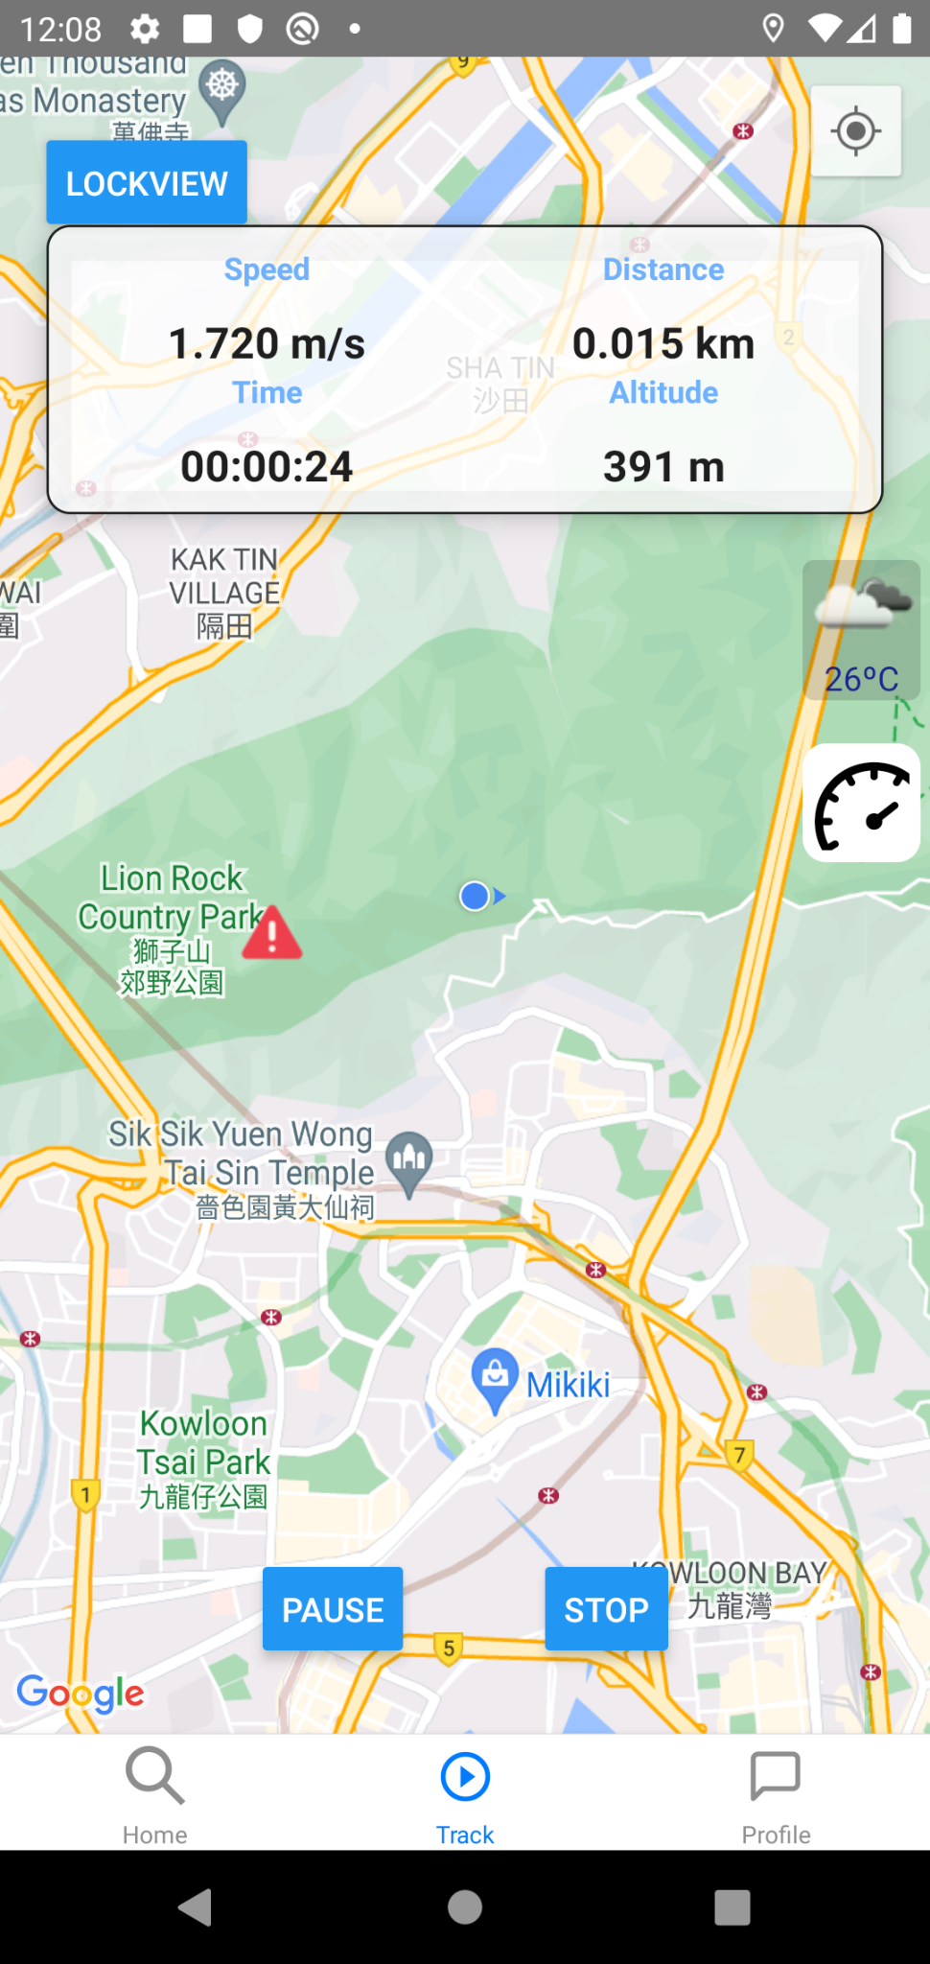
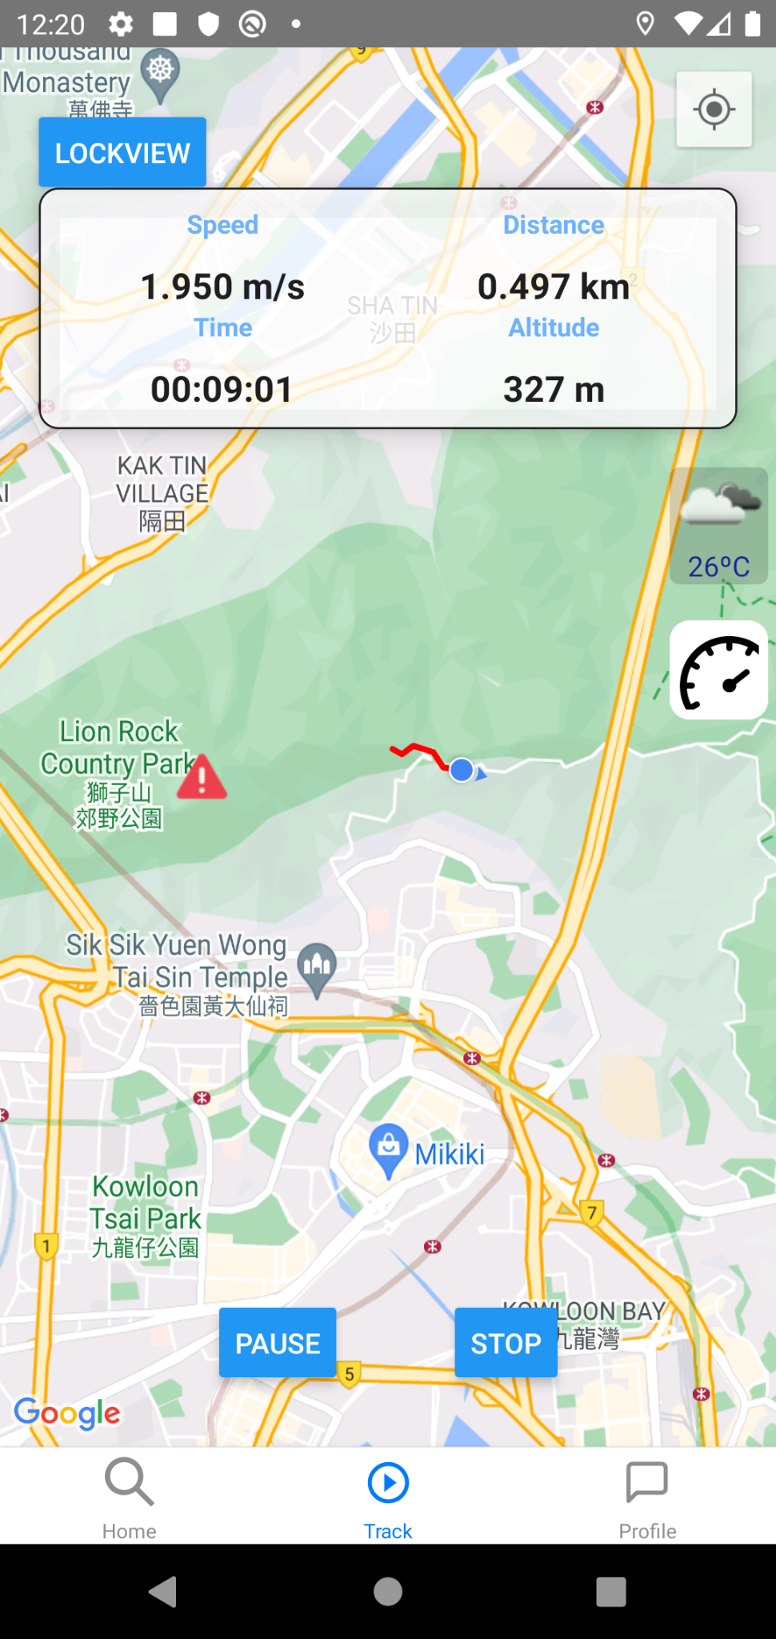
Tracking Page UI
Pressable “On/Off” Dashboard
Information is shown on dashboard
RouteLine for walked routes

Slide 13
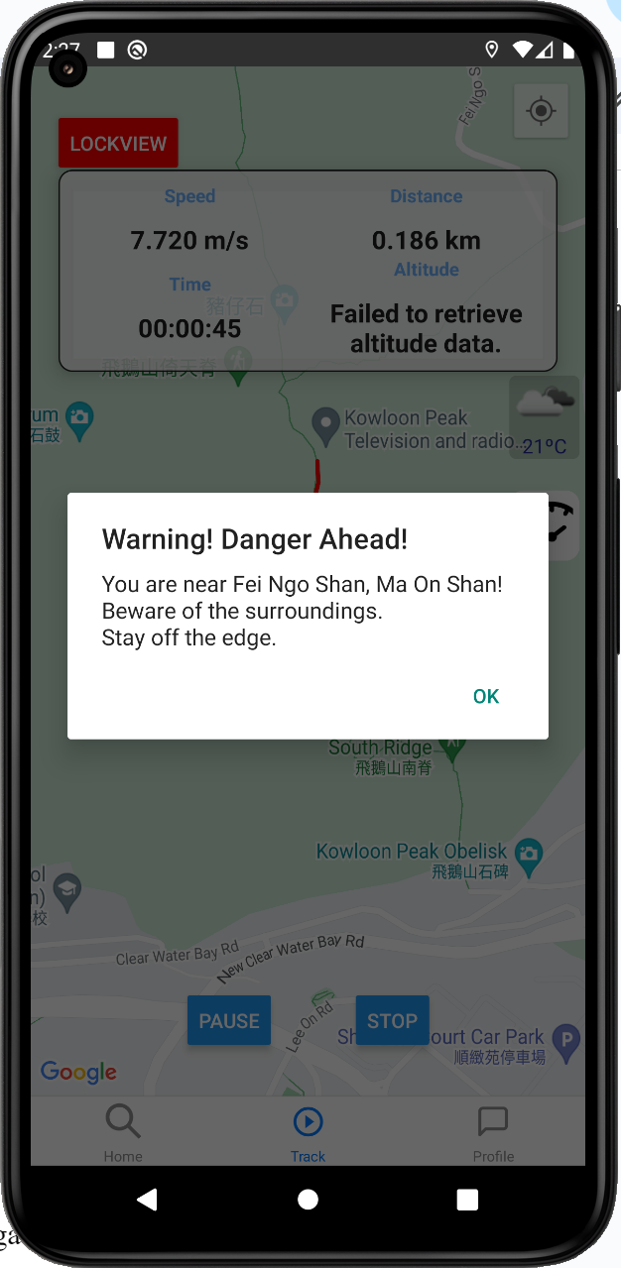
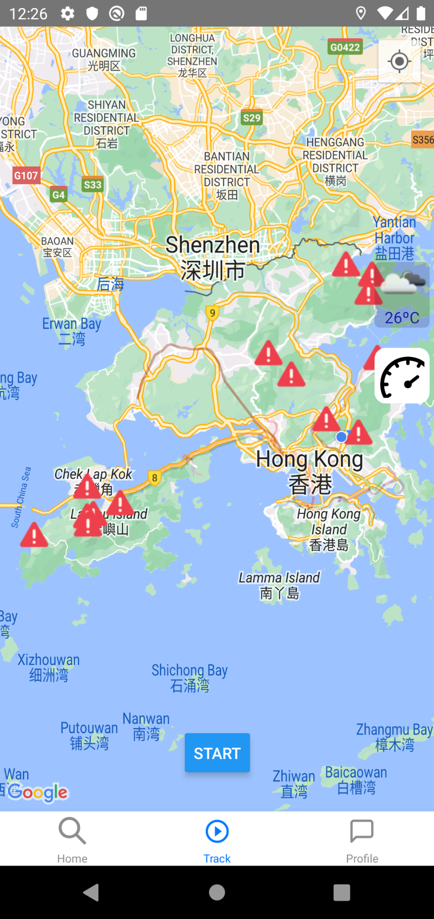
Blackspot Alert UI
Hazard Markers for Blackspots
Alert showing warnings

Slide 14
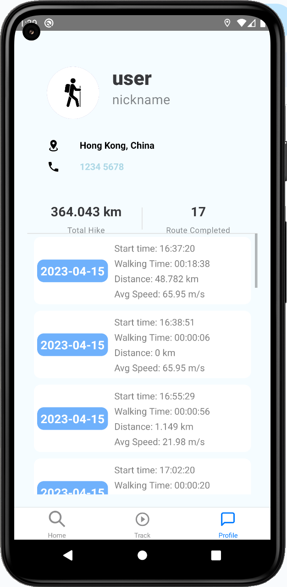
Profile Page UI
Mainly user’s data from database
Username/previous datas
Scrollable Flatlist with Total Distance and Routes

Slide 15
Backend

Slide 16

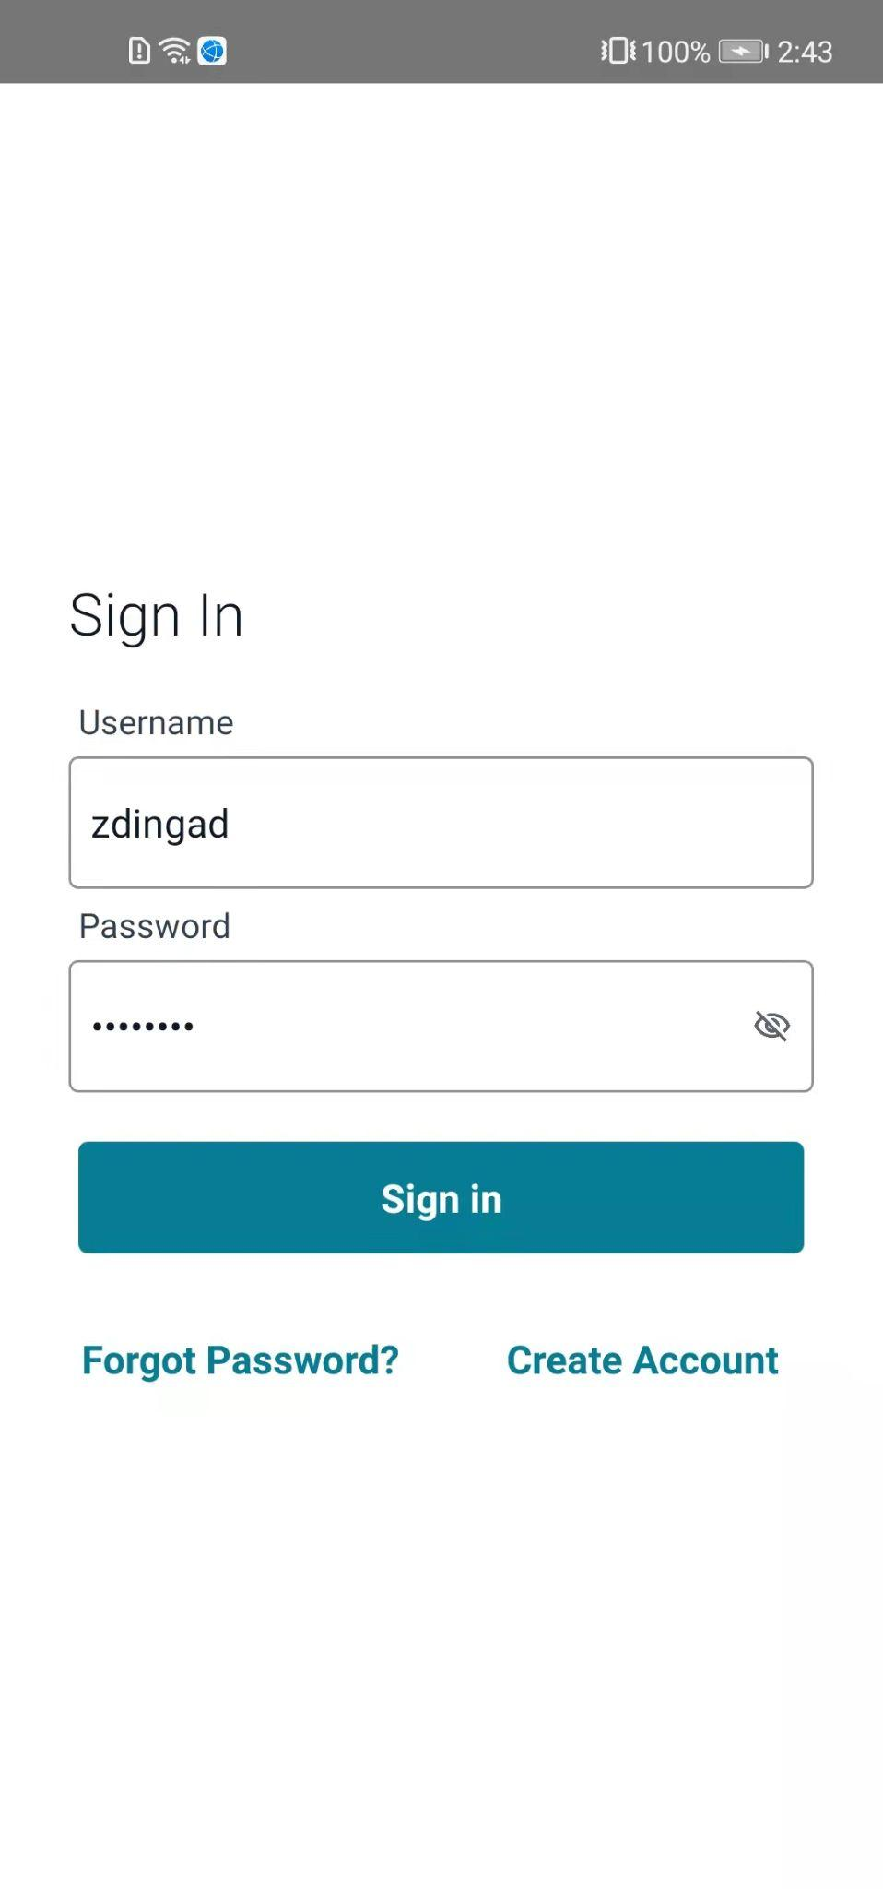
Backend overview
Database
Backend server (AWS cloud)
Frontend UI
Store data
Login
retrieve data

Slide 17
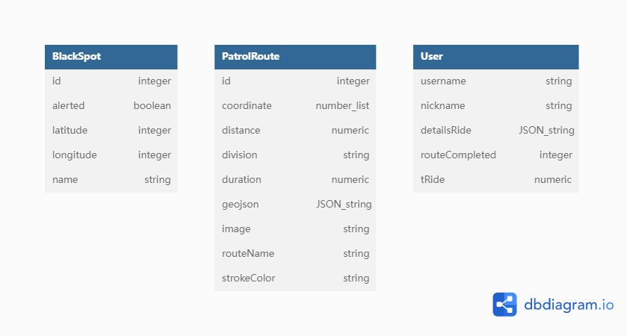
Database

Slide 18
Database

Slide 19
Database

Slide 20

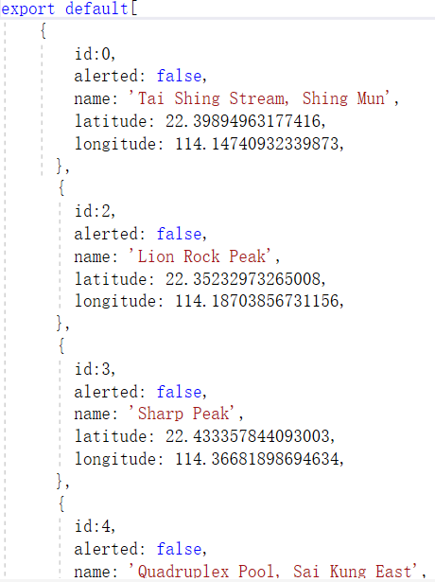
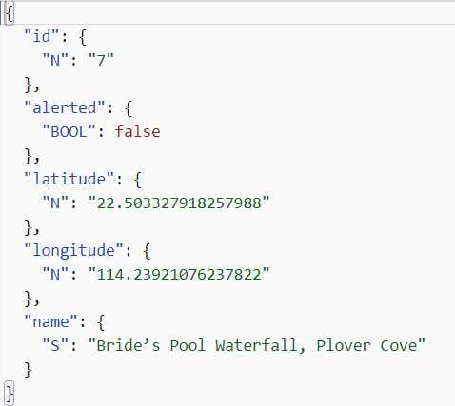
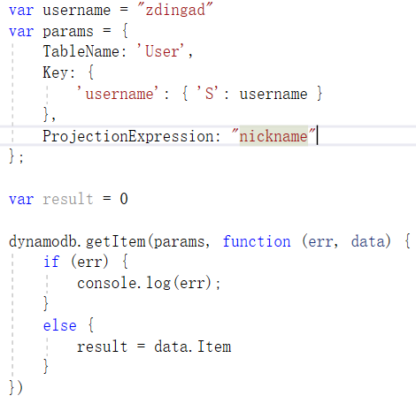
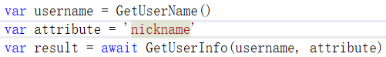
Database interface
AWS SDK
Modular structure
Data structure for communicating with the UI

Slide 21
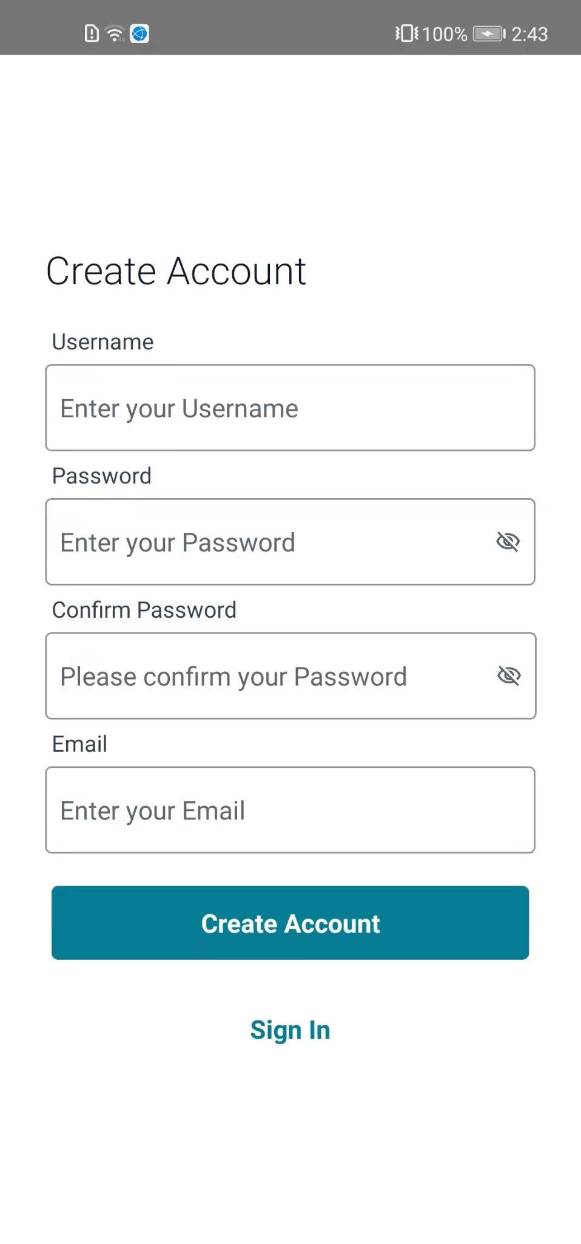
Login Page UI

Slide 22
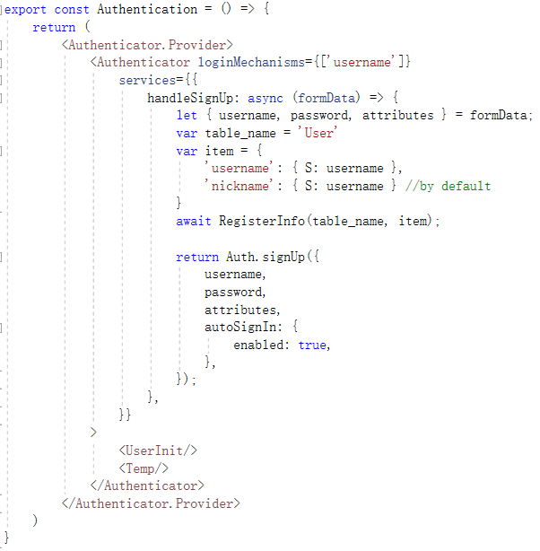
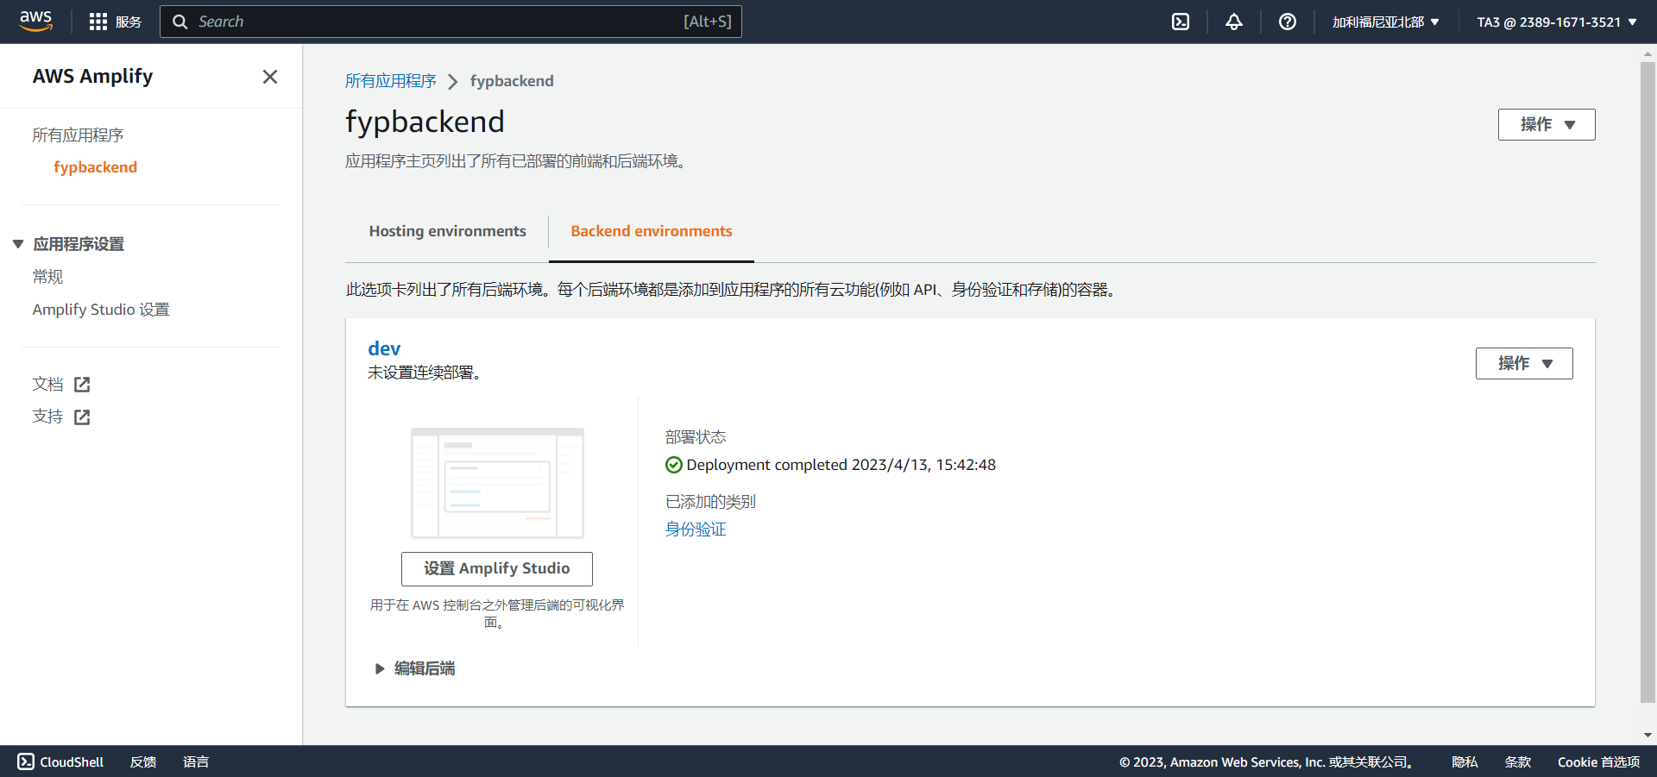
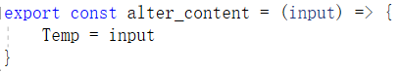
Login Workflow
AWS backend
Auth
Hook: username
Request
DynamoDB
Grant access
replace

Slide 23
Implementation and Demo

Slide 24
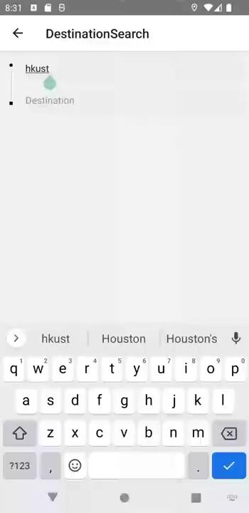
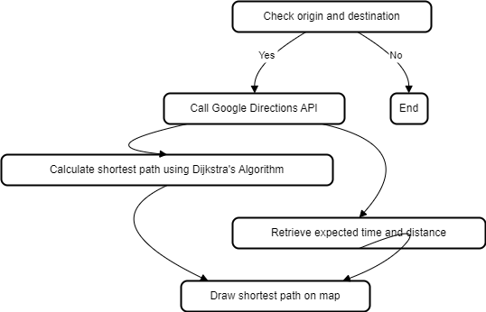
Search destination Page
GooglePlacesAutocompleteAPI
Then draw the route calculated by Dijkstra’s Algorithm

Slide 25
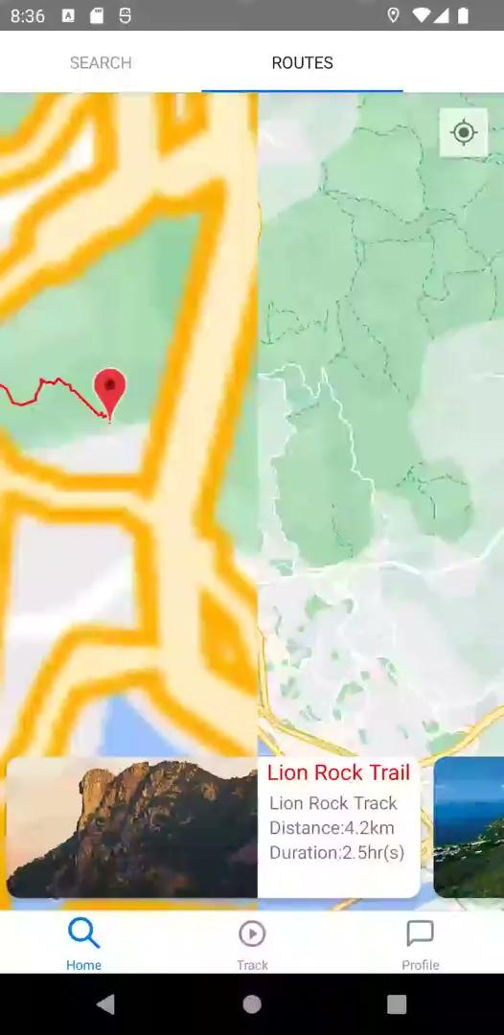
Route Recommendation
Store the coordinates in arrays form
Poyline complements
Post carousal

Slide 26
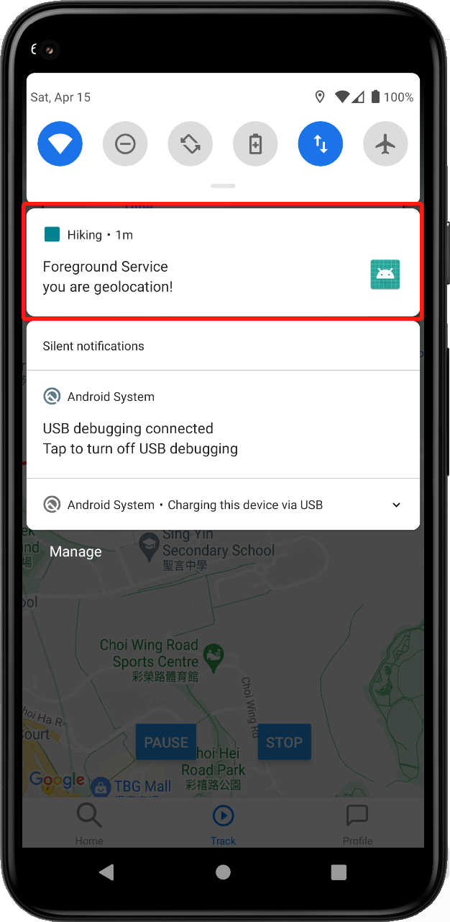
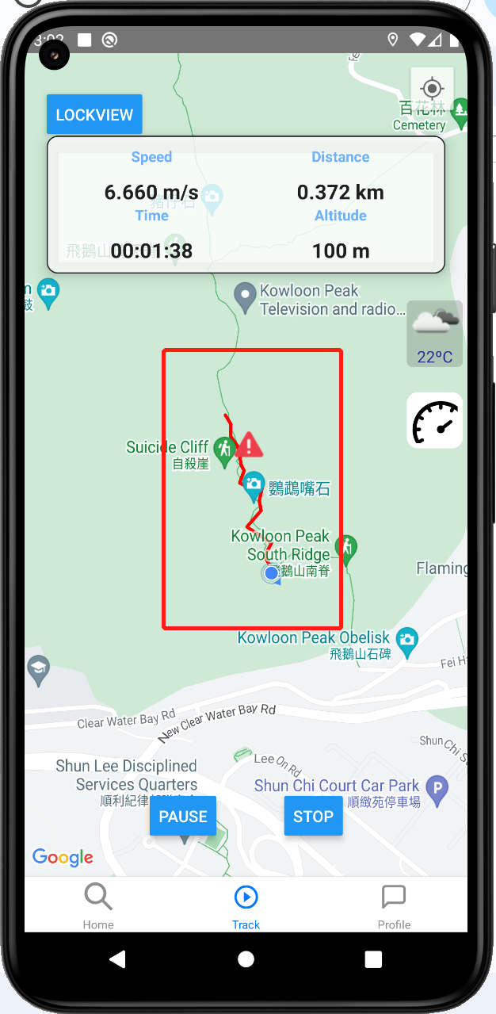
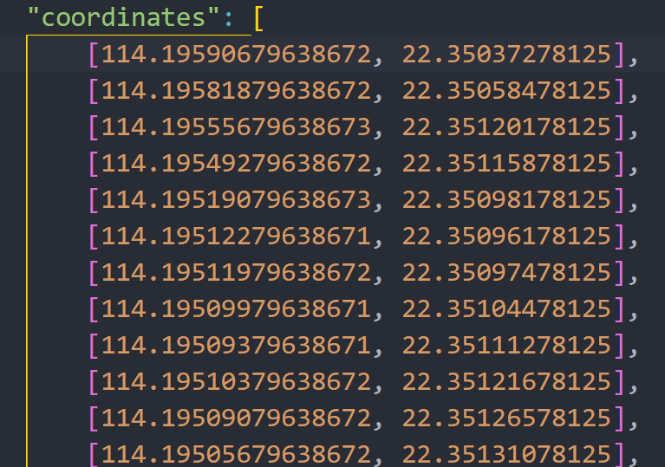
Tracking System
Foreground-service
Geolocation-service
Polyline Component

Slide 27
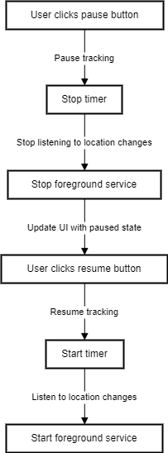

Pause Function

Slide 28
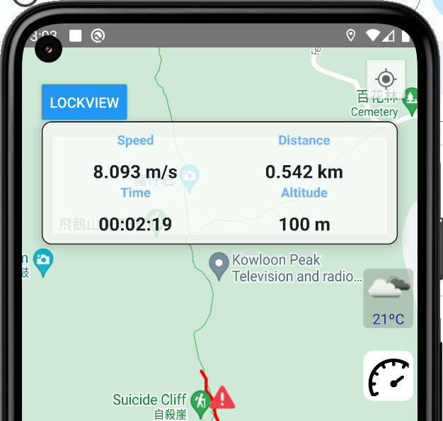
Dashboard

Slide 29
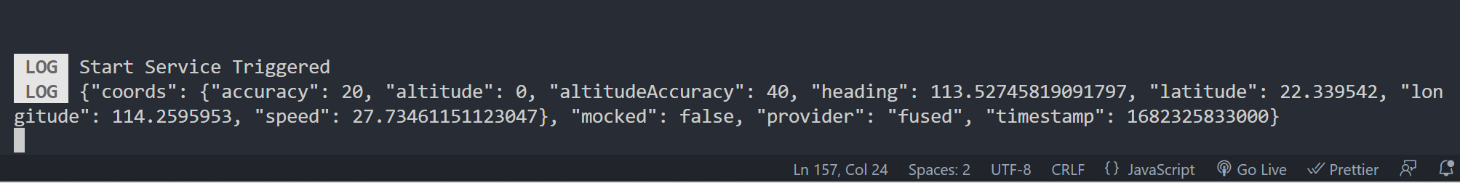
Speed
react-native-geolocation-service

Slide 30
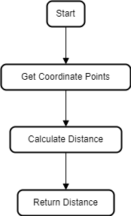
Distance
Geolib

Slide 31
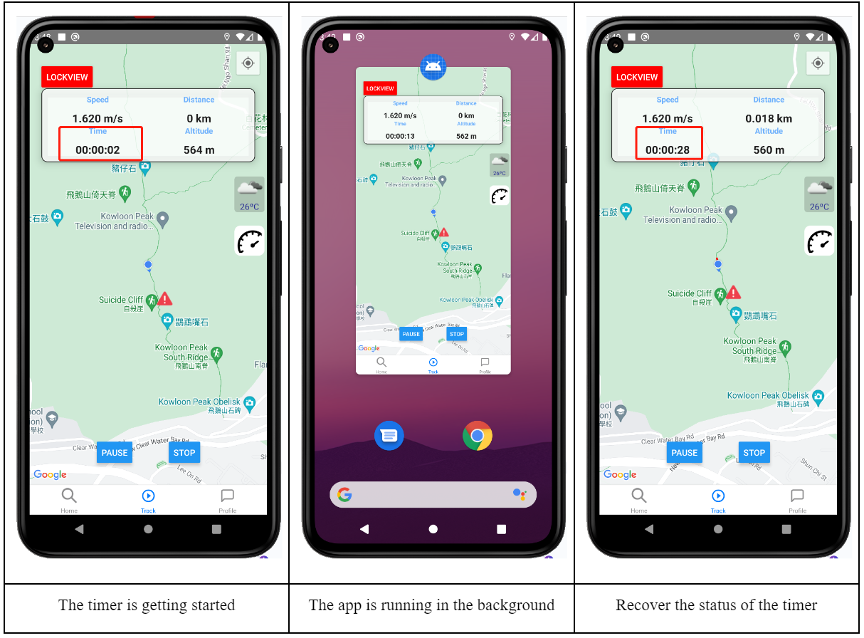
Timer
React Native Background Timer library

Slide 32
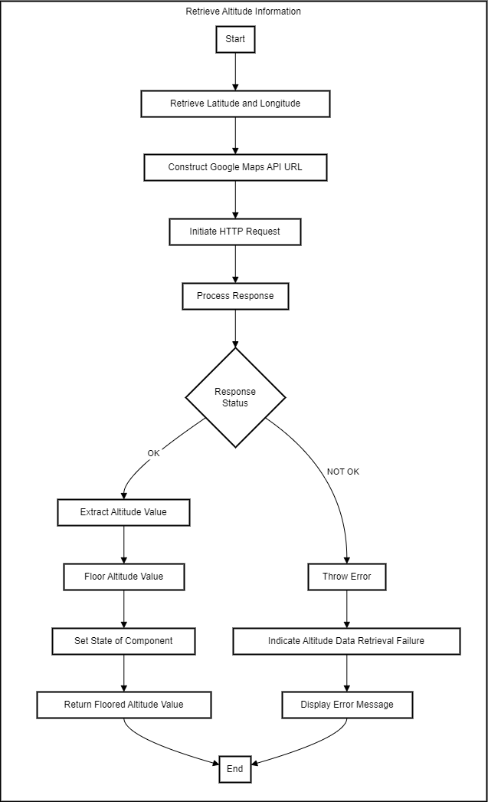
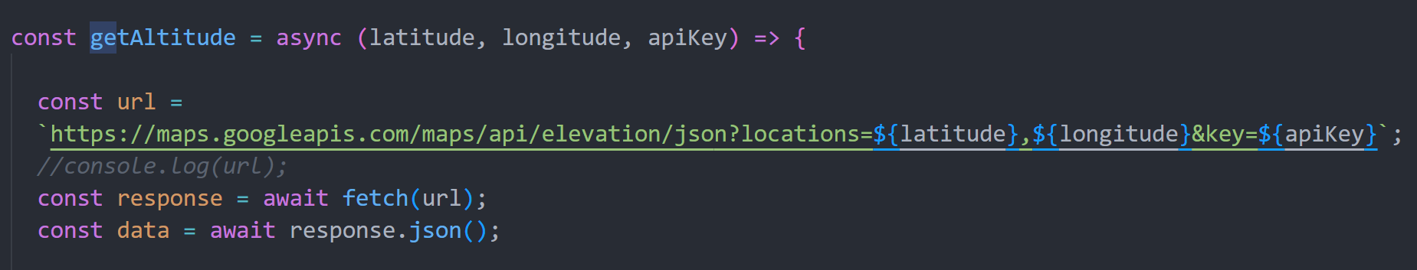
Altitude
Google Maps API URL

Slide 33

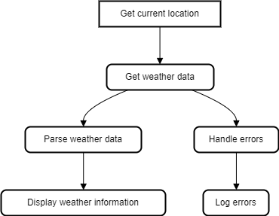
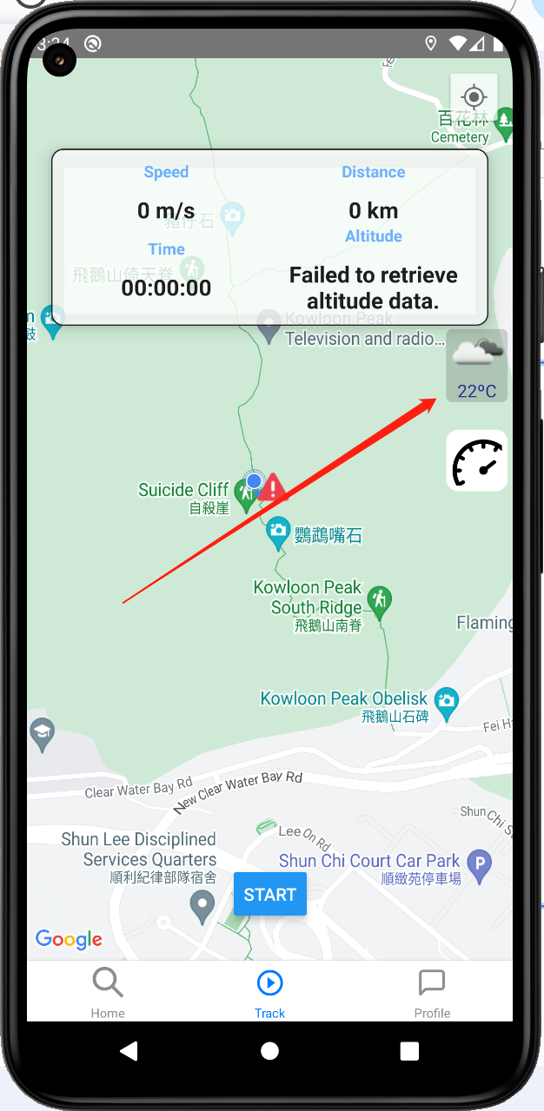
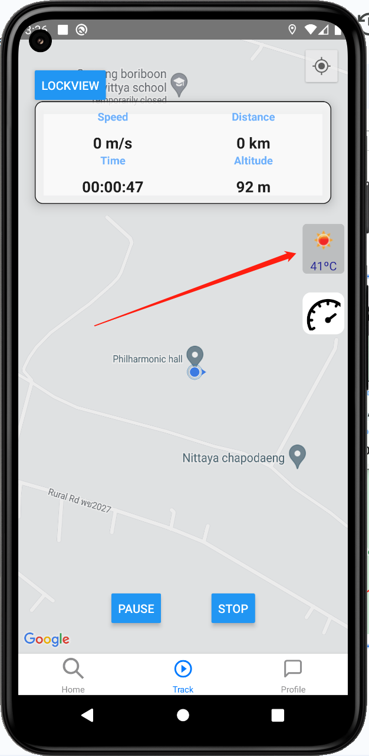
Instant Weather
It uses OpenWeather API
Hong Kong
Thailand

Slide 34

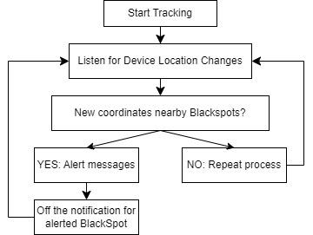
Blackspot Detection System

Slide 35

User’s Profile
Personal information
Flatlist of the records

Slide 36
Testing and Feedback
Mocking
Integration Testing
Performance Testing

Slide 37
Limitations
Offline map
Offline Tracking
Does not support other regions than Hong Kong
Personalized recommendations

Slide 38
Conclusion
Completed most main functions of our app
Achieved our objectives

Slide 39
Live Demo

Slide 40
Reference
https://www.legco.gov.hk/research-publications/english/essentials-2022ise17-promoting-hiking-safety-and-sustainability.htm

